Slide 1
AHC - Academy

Slide 2
ASP.NET Core Fundamentals
Middleware, Error Handling

Slide 3
Middleware
ASP.NET Core Middleware is software integrated inside the application’s pipeline that we can use to handle requests and responses. When we talk about the ASP.NET Core middleware, we can think of it as a code section that executes with every request.
We are going to learn how to use different methods (Run, Map, Use) during the configuration.
Additionally, we are going to take a look in the process of creating custom middleware.

Slide 4
More About the ASP.NET Core Middleware and Pipeline
Usually, we have more than a single middleware component in our application. Each component can:
Pass the request to the next middleware component in the pipeline
It can execute some work before and after the next component in the pipeline
To build a pipeline, we are using request delegates, which handle each HTTP request. To configure request delegates, we use the Run, Map, and Use extension methods. We are going to see that we can configure request delegate as an anonymous method, or as a separate reusable class. Whether we use anonymous methods or separate classes, we are creating middleware components.
Inside the request pipeline, an application executes each component in the same order they are placed in the code – top to bottom:

Slide 5
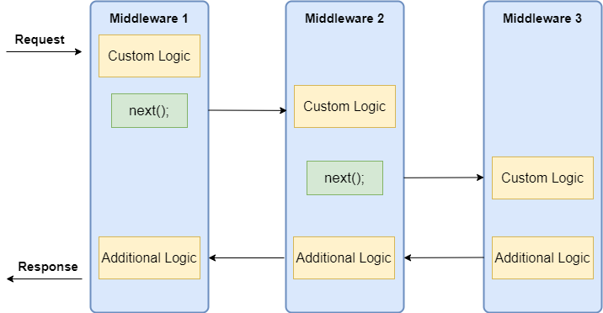

Slide 6
We can see that each component can execute custom logic before using the next delegate to pass the execution to another component. The last middleware component doesn’t call the next delegate, which means that this component is short-circuiting the pipeline. This is a terminal middleware because it stops further middleware from processing the request. Basically, it executes the additional logic and then returns the execution to the previous middleware components.

Slide 7
Middleware Order in ASP.NET Core
It is quite important to know about the order in which we should register our middleware components. The order is important for the security, performance, and functionality of our applications:

Slide 8
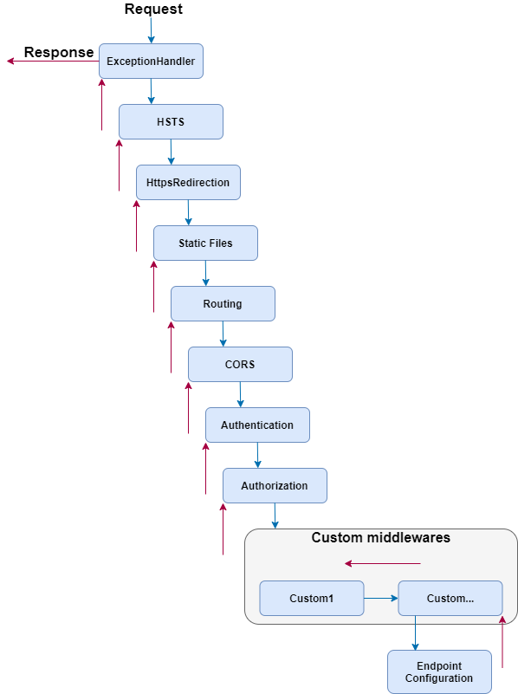

Slide 9
Demo
Middleware

Slide 10
Error handling
The exception handling features help us deal with the unforeseen errors which could appear in our code. To handle exceptions, we can use the try-catch block in our code as well as finally keyword to clean up resources afterward.
Even though there is nothing wrong with the try-catch blocks in our Actions in Web API project, we can extract all the exception handling logic into a single centralized place. By doing that, we make our actions more readable and the error handling process more maintainable. If we want to make our actions even more readable and maintainable, we can implement Action Filters.

Slide 11
Demo
Error Handling

